Slide 1
DBMS PROJECT FIFA WORLD CUP DATABASE
SHUBHAM SINGHA ROY (21CSB0B53)
KANISHKA RAHI (21CSB0B26)

Slide 2
PROBLEM STATEMENT:- In FIFA world cup the amount of data that we want to deal with is humongous.This database management system aims at building an efficient system to manage data tactfully. The database contains information about players,venues,goals,matches and a lot more stuff. Users can use the database to calculate statistics about teams, players, managers, and referees. Users can also use the data to predict match results.

Slide 3
CONTENTS:- 1) ER model assumptions 2) ER Diagram 3) Tables 4) Functional Dependencies & Primary key 5) Normalization 6) Relational Schema 7)SQL CODE

Slide 4
ER MODEL ASSUMPTIONS i.There are two stages of the tournament which are Knockout and League stages. ii.Each match is officiated by only one referee. iii.Each country belongs to only one confederation. iv.Each player can be part of only one team. v.Each stadium can have only one match at a time.

Slide 5
TABLE INFORMATION
T
Tournament:-This dataset records all World Cup tournaments.
There is one observation per tournament.
It includes the host of the tournament, the winner of the tournament,
the start and end dates of the
tournament, and information about the format of the tournament.

Slide 6
Confederations: This dataset records all FIFA confederations. There is one observation per confederation. There are 5 variables and 6 observations .
Squads: This dataset records the composition of each squad. There is one observation per player per team per tournament.
Teams: This dataset records all teams who have participated in a World Cup match
.
Players: This dataset records all players who have participated in a World Cup match, including players on the bench.
There is one observation per player. It includes their name, their birth date,and more.
Goals: This dataset records all goals.
There is one observation per goal. It indicates the team that scored the goal, player who scored the goal,
the team of the player who scoredthe goal (to account for own goals),
minute of the goal, and whether the goal was scored in the run of play by the opposition, was an own goal, or was a penalty.
Matches: This dataset records all World Cup matches. There is one observation per match per tournament. It includes the home team, the away team, the date
of the match, the country, city, and stadium that the match was played in, the final score, the score margin for each team, whether the match went to extra time, whether
there was a penalty shootout, the number of penalties scored in the shootout (if applicable), the result of the match (home team win, away team win, draw, replayed), and the winner (if applicable).

Slide 7
Groups: This dataset records the names of the groups for each group stage. There is one observation per group per group stage per tournament. Some tournaments have multiple group stages.
Tournament_standings: This dataset records the final standings for each tournament. There is one observation per position per tournament.
Award_winners: This dataset records all award winners. There is one observation per player per award per tournament. Some awards are shared by multiple players. It indicates the name of the award, the player(s) who won the award, the team of the player(s) who won the award,

Slide 8
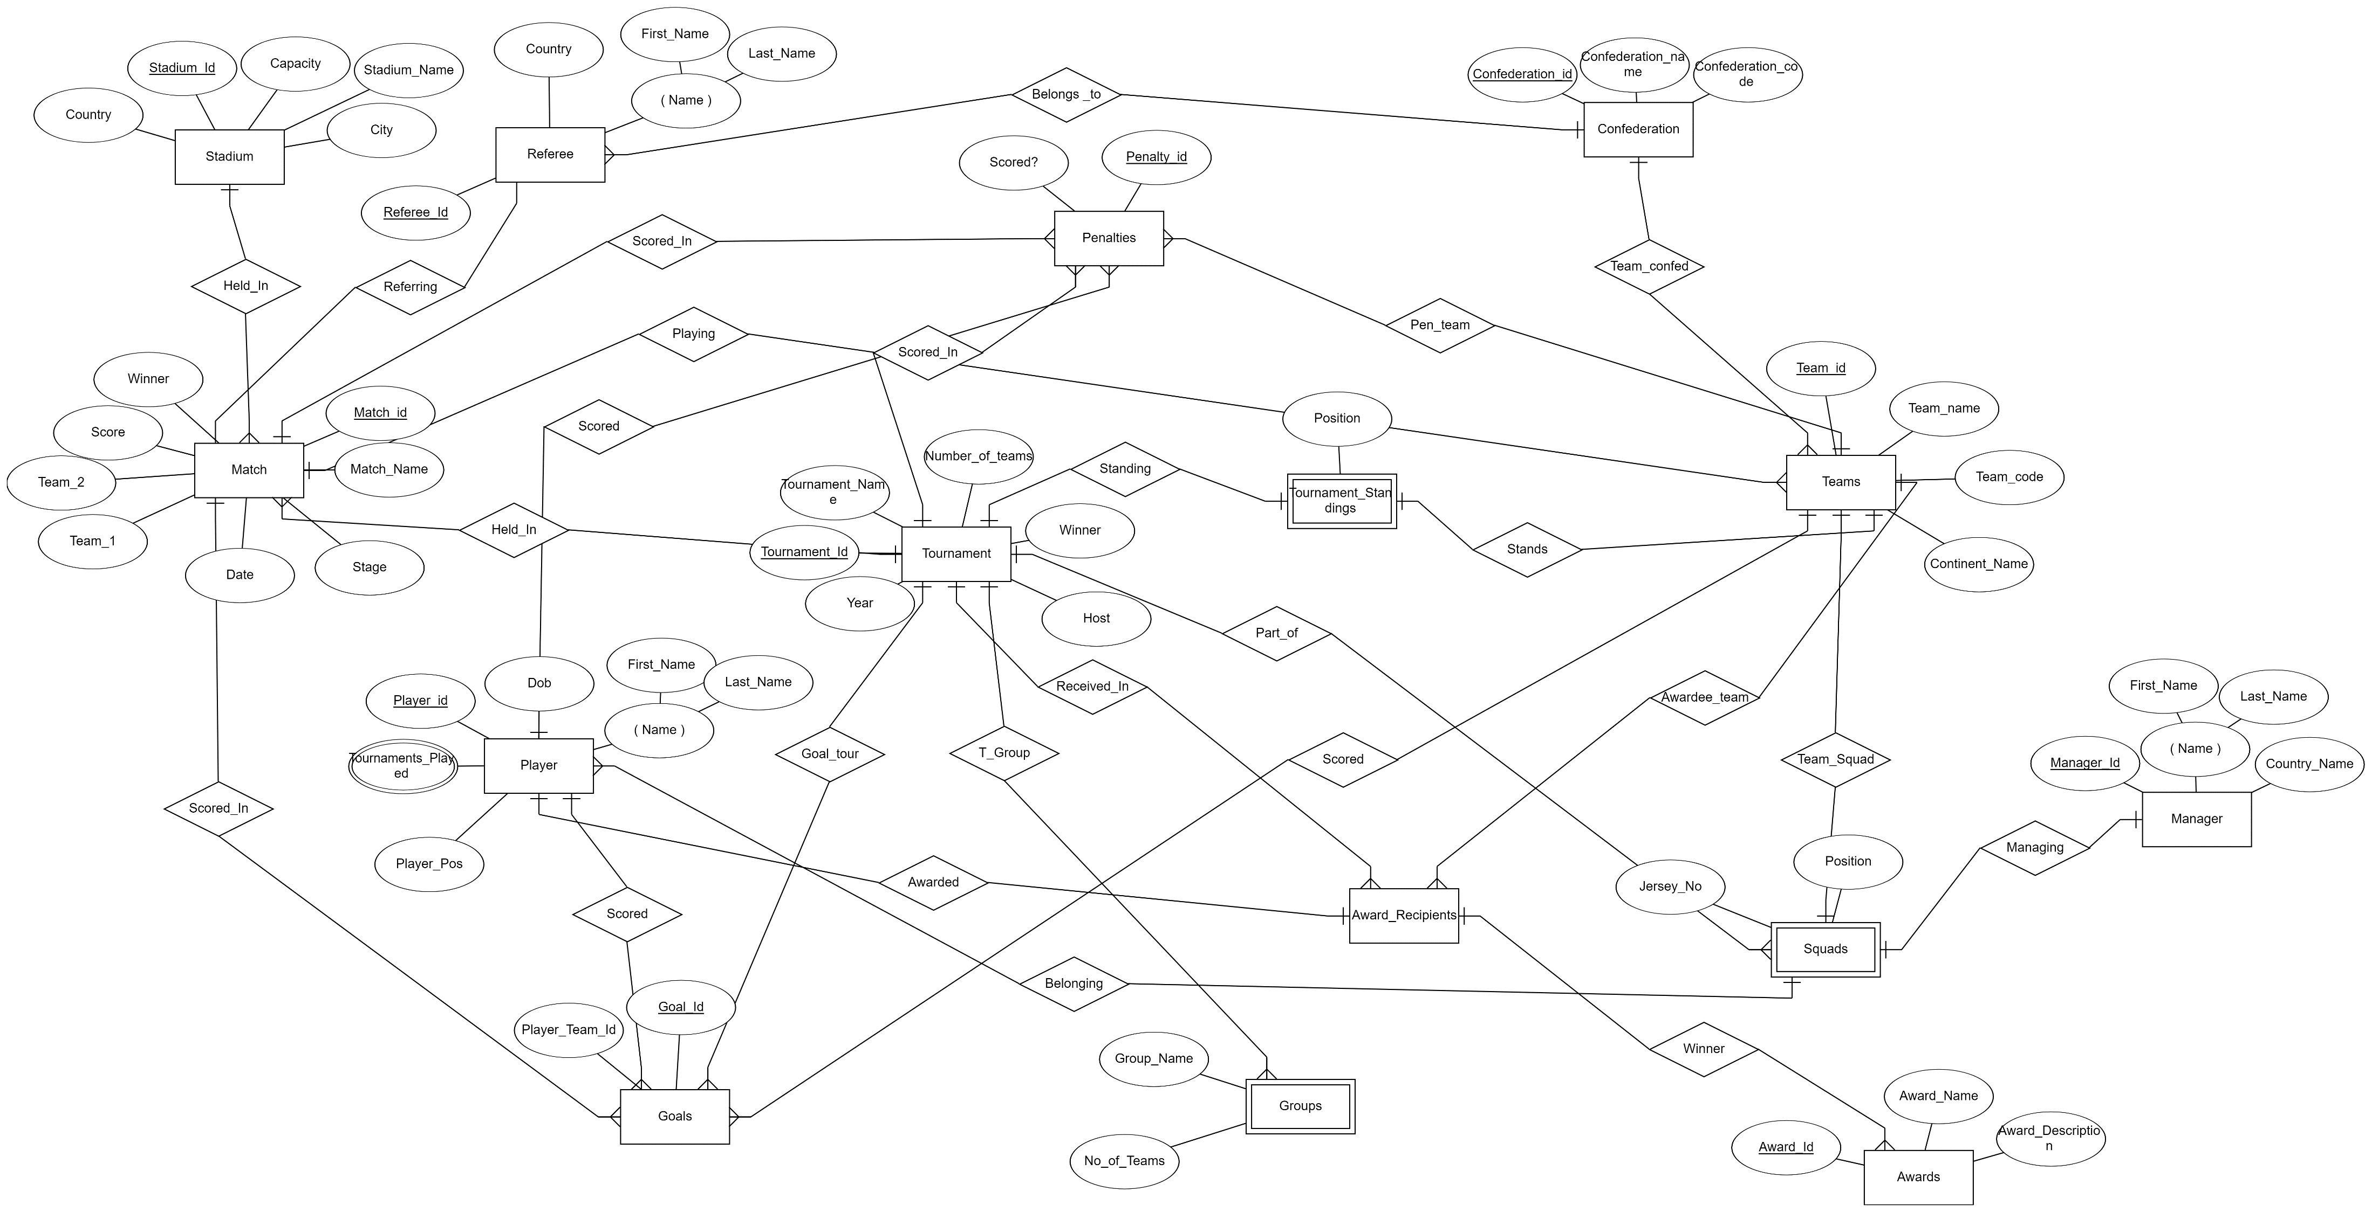
ER DIAGRAM

Slide 9
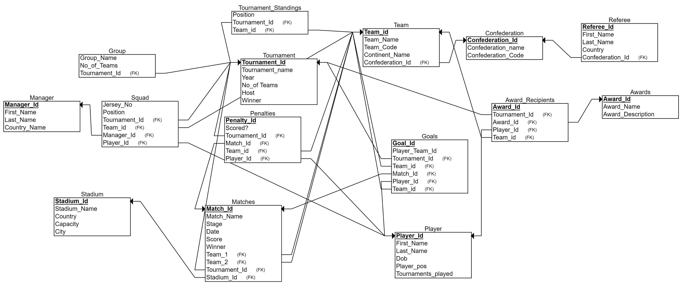
RELATIONAL SCHEMA

Slide 10
THANK YOU

